Slide 1

Pre-AP: Empowering
Every Student to Learn, Grow,
and Succeed
Pre-AP School and District Leaders

Slide 2
Agenda:
I
What is Pre-AP?
II
Why Pre-AP?
Alignment of Instruction
III
IV
Program Commitments
V
Q & A

Slide 3

What Is Pre-AP?
I

Slide 4




Pre-AP Approach to Teaching and Learning
Horizontally and Vertically Aligned Instruction
Shared Principles, Areas of Focus
The three approaches are as follows:
Focused Content
Course Frameworks, Model Lessons
High-Quality Professional Learning
Educators Bring it All Together
Targeted Assessments and Feedback
Learning Checkpoints, Performance Tasks, Final Exam
Notes:
Pre-AP courses invite all students to learn, grow, and succeed through focused content, horizontally and vertically aligned instruction, and targeted assessments for learning. Pre-AP Professional Learning prepares teachers and leaders to use Pre-AP in their schools.

Slide 5


Pre-AP Courses
These High School Level Courses may be used at the grade-level that is appropriate based on local requirements and practices, including middle school.
English
Mathematics
Pre-AP English 1
Pre-AP English 2
Pre-AP Algebra 1
Pre-AP Geometry with Statistics
Pre-AP Algebra 2
Five photos depict five different subjects, namely, English, Mathematics, Social Studies, Science, and Arts. Each subject lists the available Pre-A P courses below the photo.
Social Studies
Science
Pre-AP World History and Geography
Pre-AP Biology
Pre-AP Chemistry
Arts
Pre-AP Dance
Pre-AP Music
Pre-AP Theatre
Pre-AP Visual Arts

Slide 6
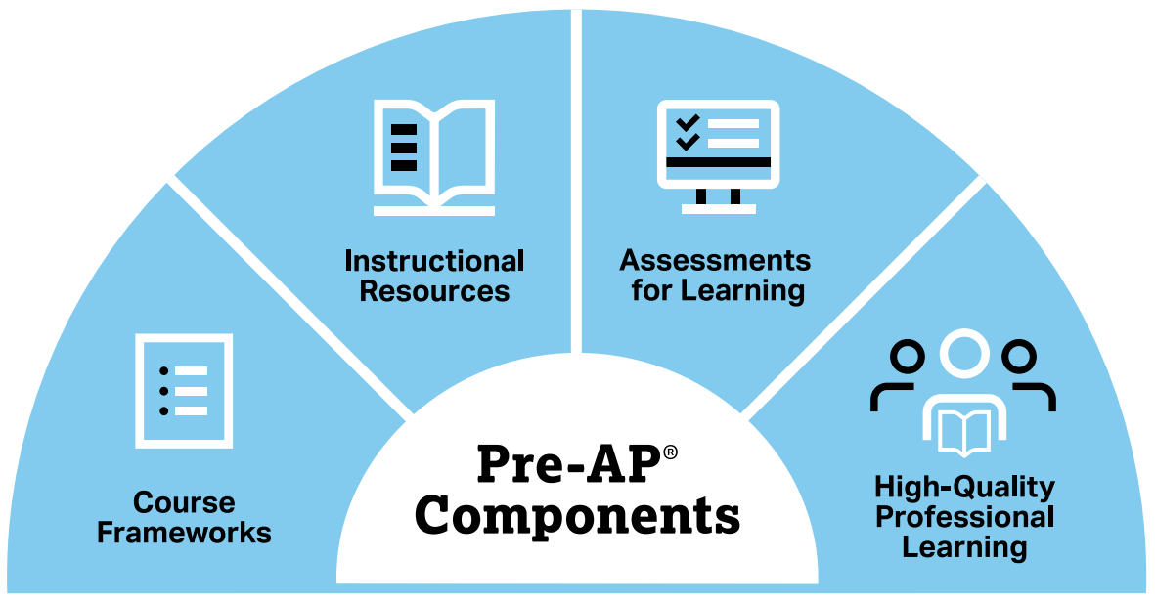
Pre-AP Course Components
The Pre-AP Program is designed to give all students the opportunity to learn the foundational knowledge and critical thinking skills they need to achieve their full potential.
The Pre-AP Components provide students the four key resources recommended by TNTP:
Grade-appropriate assignments
Strong instruction
Deep engagement
High expectations
Notes:
Course frameworks
Provide clear and focused description of what students should know and be able to do as a result of the course.
Increases clarity and provides transparency to both teachers and students about the most essential knowledge and skills students will need for active, confident participation in subsequent high school courses, including Advanced Placement courses, as well as college coursework and postsecondary careers.
Deeply informed by state standards documents.
Instructional Resources
Model lessons that feature motivating classroom activities, engaging texts and challenging practice.
Intended to model for teachers how to develop engaging instruction that addresses the content and skills of the course framework as well as bring the shared principles to life.
Provided digitally (in print for cost)

Slide 7
Flexibility to Meet Your Students’ Needs
Pre-AP course frameworks are aligned to College and Career Readiness and AP standards.
Pre-AP courses are designed to support student success in PSAT-related assessments, SAT, AP, and other college readiness indicators.
Pre-AP doesn’t cover 100% of instructional time.
Pre-AP courses will address most of your state standards, and we provide standards crosswalks.
Our program is intentionally flexible and can sit alongside your existing curriculum and allow you to use your local content to address specific state standards not covered in Pre-AP.

Slide 8
Stop, Think, Discuss: What is Pre-AP?
What excites you about Pre-AP? What concerns you?
How do you see the Approach to Teaching and Learning addressing a need at our school?
What specific questions do you have about Pre-AP Components?
Notes:
Consider including additional slides from the Source Deck
Select question(s) from the slide to engage audience in reflection and discussion.
Which component of Pre-AP are you most excited about? (slide 6)
How do you see the Approach to Teaching and Learning addressing a need at our school?
What specific questions do you have about Pre-AP Components?

Slide 9

Why Pre-AP?
II

Slide 10
Pre-AP for All
Pre-AP frameworks and assessments serve as the foundation for all sections of the course at the school.
Pre-AP Equity and Access Policy: College Board believes that all students deserve engaging and challenging grade-level coursework. Increasing access to this type of coursework leads to increased opportunities for all students, including groups that have been traditionally underrepresented in AP and college classrooms. Therefore, the Pre-AP program is dedicated to collaborating with educators across the country to ensure all students have access to meaningful classroom experiences that allow them to learn, grow, and build their confidence. It is only through a sustained commitment to equitable preparation and access that true excellence can be achieved for all students, and the Pre-AP course designation requires this commitment.
Notes:
Pre-AP for all means that PreAP frameworks and assessments ARE the foundation for ALL sections of the particular course.
The Pre-AP Equity and Access Policy highlights that all students deserve this opportunity.
The Pre-AP®Program recognizes the autonomy of secondary schools and districts in setting course participation policies that best meet their students’ unique needs and learning goals. At the same time, Pre-AP courses are specifically designed to provide grade-level course work based on high school content, skills, and expectations.

Slide 11


Benefits of Pre-AP
Students
Teachers
Schools
Access and Opportunity
Critical Thinking Skills
Increased Engagement and Growth through Motivating Resources
Engaging Model Lessons
Course Frameworks provide Focus
Learning Checkpoints
Cross-Curricular Alignment: 12 courses in 5 content areas
Teacher Collaboration
Professional Growth

Slide 12
I've noticed that the students have started to adopt more of a growth mindset. We've been focusing on learning that struggling is okay and making mistakes is okay. We're taking a lot of time to do things, but they're gaining skills along the way.
Quote from our focus groups of teachers during the 2019-2020 school year
Notes:
This is a quote from our focus groups of teachers during the 2019-2020 school year.

Slide 13

Student Impact
Notes:
Please play the following video on YouTube: https://youtu.be/u5mkCKOhKlY

Slide 14
Stop, Think, Discuss: Why Pre-AP?
How do you see the benefits of Pre-AP most impacting our students and teachers?
What are the concerns / opportunities you see in offering Pre-AP to all students?
How does Pre-AP align with our school / district goals?
Notes:
Select question(s) from the slide to engage audience in reflection and discussion.
Consider including additional slides from the Source Deck
How do you see the benefits of Pre-AP most impacting our students and teachers?
What are the concerns / opportunities you see in offering Pre-AP to all students?
How does Pre-AP align with our school / district goals?

Slide 15
Alignment of Instruction
III
Notes:
Shared principles cut across all Pre-AP courses and disciplines.
Each course is also aligned to discipline-specific areas of focus that prioritize the critical reasoning skills and practices central to that discipline.

Slide 16
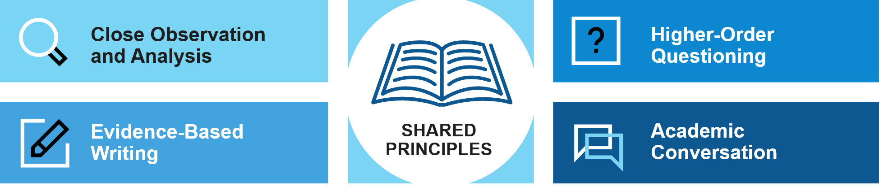
Pre-AP Shared Principles
All Pre-AP courses have a set of shared principles, which enables students of every ability level to build cross-disciplinary critical thinking skills.
Notes:
Shared Principles - horizontal alignment of instruction that cross all Pre-AP courses

Slide 17

Close Observation And Analysis
Students are provided time to carefully observe one data set, text, image, performance piece, or problem before being asked to explain, analyze, or evaluate.
This creates a safe entry point to simply express what they notice and what they wonder. It also encourages
students to slow down and capture relevant details with intentionality to support more meaningful analysis, rather than rushing to completion at the expense of understanding.

Slide 18

Evidence-Based Writing
With strategic support, students frequently engage in writing coherent arguments from relevant and valid sources of evidence.
Pre-AP courses embrace a purposeful and scaffolded approach to writing that begins with a focus on precise and effective sentences before progressing to longer forms of writing.

Slide 19

Higher-Order Questioning
Students engage with questions designed to encourage thinking that is elevated beyond simple memorization and recall. Higher-order questions require students to make predictions, synthesize, evaluate, and compare.
As students grapple with these questions, they learn that being inquisitive promotes extended thinking and leads to deeper understanding.

Slide 20

Academic Conversation
Through peer-to-peer dialogue, students’ ideas are explored, challenged, and refined. As students engage in academic conversation, they come to see the value in being open to new ideas and modifying their own ideas based on new information.
Students grow as they frequently practice this type of respectful dialogue and critique and learn to recognize that all voices, including their own, deserve to be heard.

Slide 21
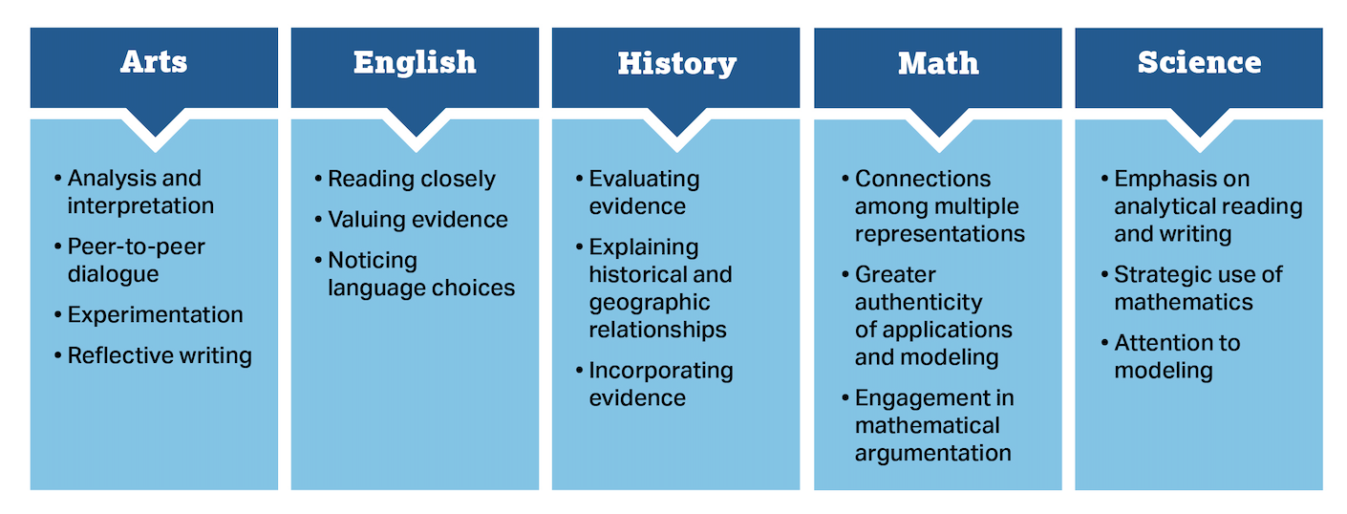
Areas of Focus
Shared Principles
Close Observation and Analysis | Evidence-based Writing | Higher-Order Questioning | Academic Conversation
Notes:
Each course is also aligned to discipline-specific areas of focus that prioritize the critical reasoning skills and practices central to that discipline.
The areas of focus are discipline-specific reasoning skills that students develop and leverage as they engage with content.
Whereas the shared principles promote horizontal alignment across disciplines, the areas of focus provide vertical alignment within a discipline, giving students the opportunity to strengthen and deepen their work with these skills in subsequent courses in the same discipline.

Slide 22
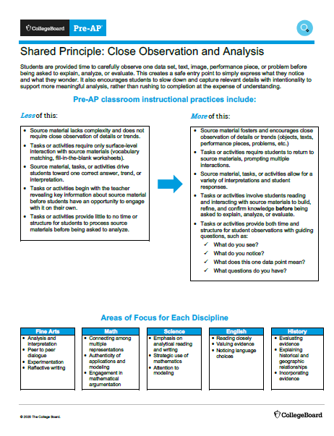
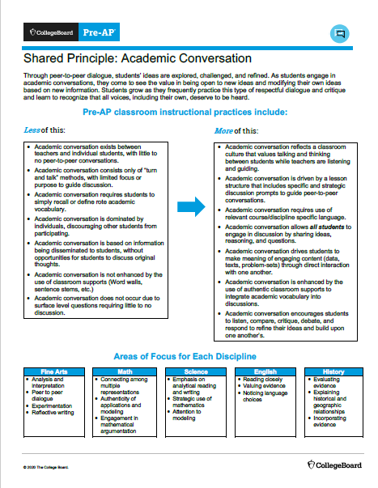
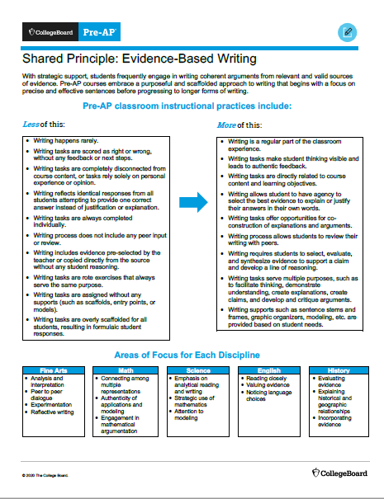
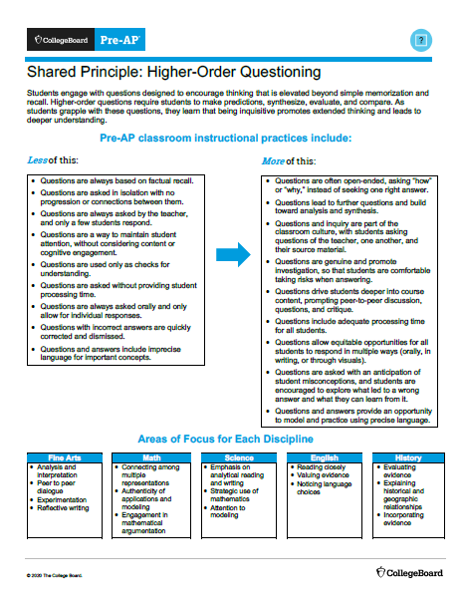
Shared Principles Instructional Practices
Notes:
These Shared Principle Instructional Practices help leaders better understand the instructional shifts they should see in Pre-AP classrooms
Recommendation: Review these documents with leaders, available on Pre-AP Classroom under Pre-AP Leader Resources

Slide 23
Stop, Think, Discuss: Alignment of Instruction
How does Pre-AP’s alignment of instruction support what we’re already doing well? How can it help us improve?
How could the areas of focus provide clarity and cohesion within a content area?
As instructional leaders, how might we use the Classroom Instructional Practices documents to guide and support instruction?
Notes:
Consider including additional slides from the Source Deck
Select question(s) from the slide to engage audience in reflection and discussion.

Slide 24
Pre-AP Program Commitments
IV

Slide 25
Pre-AP Program Commitments
Pre-AP for All: Pre-AP frameworks and assessments serve as the foundation for all sections of the course at the school.
Course Frameworks: Teachers align classroom instruction to the course frameworks.
Assessments: Teachers administer at least 1 learning checkpoint per unit, and 4 performance tasks.
Professional Learning: Teachers and the Pre-AP Coordinator complete professional learning offered by the College Board.
Notes:
Schools participating in the College Board Pre-AP Program must go through the Pre-AP Course Audit. The Pre-AP Course Audit ensures that all teachers and course audit administrators agree to complete specific activities to receive an official Pre-AP course designation. This is a commitment they make to their students, fellow teachers, and school leadership.
The Pre-AP Course Audit is intended to:
Give Pre-AP teachers and coordinators clear guidelines on curricular, resource, and implementation commitments that each Pre-AP course agrees to in order to receive a Pre-AP course designation.
Give colleges and universities confidence that Pre-AP courses are designed to meet the same criteria across all schools.
Note: You may pull additional slides for each Pre-AP program commitment from the Source Deck
Optional language: School leadership may defer the Pre-AP For All commitment under the following conditions:
School refrains from establishing any entry barriers (e.g., minimum test scores, previous grades, or teacher recommendation) which could hinder students’ participation in the Pre-AP course
School develops a plan to increase enrollment of students in Pre-AP courses over time
The Pre-AP program will monitor course enrollment for schools who defer this commitment.

Slide 26
Stop, Think, Discuss: Pre-AP Program Commitments
Pre-AP for All: Pre-AP frameworks and assessments serve as the foundation for all sections of the course at the school.
Course Frameworks: Teachers align classroom instruction to the course frameworks.
Assessments: Teachers administer at least 1 learning checkpoint per unit, and 4 performance tasks.
Professional Learning: Teachers and the Pre-AP Coordinator complete professional learning offered by the College Board.
What resources or supports need to be in place to meet each of the four program commitments?
What questions do you have about these program commitments?
Notes:
Consider including additional slides from the Source Deck
Select question(s) from the slide to engage audience in reflection and discussion.

Slide 27

Q & A
V

Slide 28


Thank you
preap@collegeboard.org
preap.org
© 2021 College Board

